Slide 1
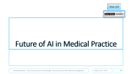
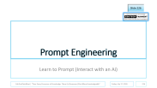
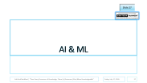

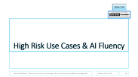
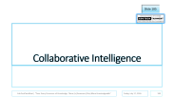

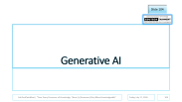
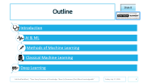
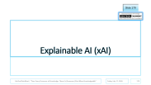
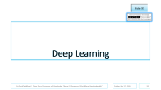
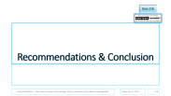



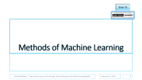
Theoretical Foundations – Introduction to AI, xAI, Ethical AI and Collaborative Intelligence

Slide 2
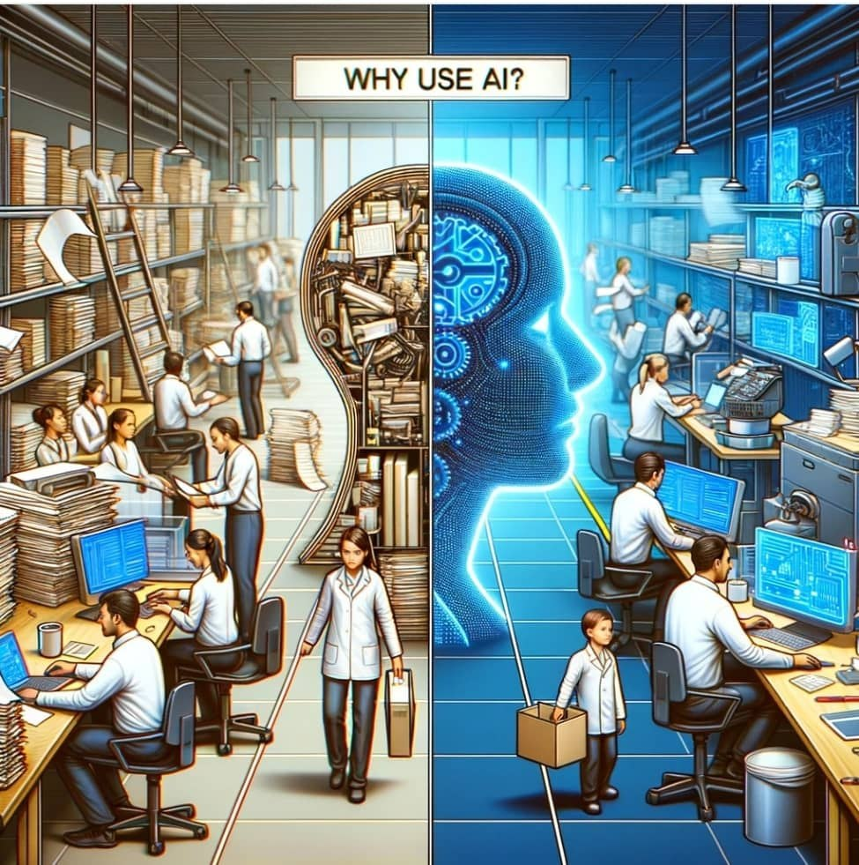
Resident Doctors Weekly Seminar
Department of Anaesthesia and Intensive Care
Aminu Kano Teaching Hospital (AKTH)
Module 1
Theoretical Foundations – Introduction to AI, xAI, Ethical AI and Collaborative Intelligence

Slide 3



Resident Doctors Weekly Seminar
Dept of Anaesthesia and Intensive Care
Aminu Kano Teaching Hospital (AKTH)
Presents
Introduction to AI, xAI, Ethical AI and Collaborative Intelligence

Slide 4
Introduction to AI, xAI, Ethical AI and Collaborative Intelligence
A Lecture Delivered During the Resident Doctors Weekly Seminar at the Dept o Anaesthesia and Intensive Care, Aminu kano Teaching Hospital on Friday 17th July 2026

Slide 5
Introduction to AI, xAI, Ethical AI and Collaborative Intelligence
Dr. Abdulwasiu B. Popoola
Resident, Dept of Anaesthesia and Intensive Care,
Aminu Kano Teaching Hospital

Slide 6
Preamble – Online AMA/Polls Sessions
Kindly ask your questions (also supports anonymous posts) using the slido Q&A section with the details below.
Please try and participate in the attached polls/quizzes shared in the slido Polls section.
Join as a Participant by using the code below:
Join at slido.com
Participant code: #1539786

Slide 7
Preamble – Quizzes/Polls and Live PowerPoint Slides
To get a copy of the PowerPoint slides on your device and participate live, on your smartphones, tablets or laptop computers, kindly follow the procedure below
Visit classpoint.app
Use the following code to join:
89316

Slide 8





Outline
Introduction
AI & ML
Methods of Machine Learning
Classical Machine Learning
Deep Learning

Slide 9


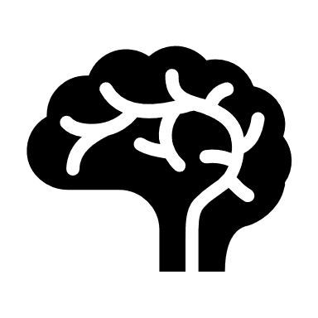

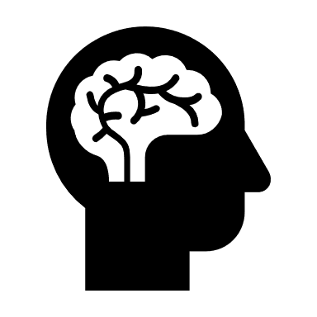
Outline – cont’d
Generative AI
Natural Language Processing and Computer Vision
Future of AI in Medical Practice
AI Ethics and Explainable AI (xAI)
Collaborative Intelligence, AI Fluency, Prompt Engineering and Conclusion

Slide 10
Introduction

Slide 11
What is Data
Data is everywhere.
Data is derived from the Latin word datum, meaning fact.
There are two main formats of data:- structured and unstructured.

Slide 12
What is Data – cont’d
Data can also be quantitative or qualitative.
The world most valuable resource is no longer oil, but data - The Economist, May 6th 2017.
Metadata refers to the data context.

Slide 13
Oil Vs. Data
Infinite vs. Finite: Oil is a scarce, depletable physical resource, whereas data is available everywhere and can be duplicated or used infinitely without disappearing.
Depreciation: Oil retains its energy value over time, but data often depreciates rapidly as information becomes outdated.
Silos vs. Spills: Oil spills cause immediate environmental damage, while data "spills" come in the form of massive privacy breaches and security hacks.

Slide 14
Value of Data in Healthcare
Approximately 1 billion people use wearable technologies like smartwatches, fitness bands, and other medical devices.
Depending on the privacy settings, these devices also transmit generated data with external parties.
Physicians can use the data to detect and predict possible disorders, improving decision-making in medicine and patient care.
These data is also used in advancement of pharmaceutical and healthcare research globally.

Slide 15
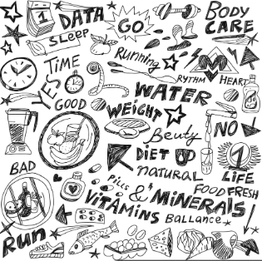
Other values of Data
Data in organizations
Data in supply chain
Data in education
Data in Finance
Etc

Slide 16
Values of Data – Cont’d
The volume of data has grown exponentially over the last decade.
According to Statistica Research, the total volume of data created, captured, copied, and consumed globally:
    In 2010 - about 2 Zettabytes (Zettabyte = 1 billion terabytes)
    In 2021 - 80 Zettabytes
    In 2025 -182 Zettabytes

Slide 17
Values of Data – Cont’d
The daily creation reaches approximately 496 million terabytes.
This massive digital universe is forecasted to expand even further to 394 zettabytes by 2028.
Consequently, data storage methods have evolved over time - cave/wall paintings -> scrolls/books of papyrus -> punch cards

Slide 18
Values of Data – Cont’d
Magnetic Tapes/Floppy Disks/USB Flash Drives
CD (Compact Discs)
HDD (Hard Disk Drives)
SSD (Solid State Drives)
Cloud Storage (Google Drive, OneDrive, etc)

Slide 19
The 5 V’s of Big Data
The 5 V’s of Big Data are a foundational framework used by data scientists and enterprise architects to define the unique characteristics, challenges, and opportunities of managing massive datasets.
Volume
Velocity
Variety
Veracity
Value
Notes:
Healthcare Application of the 5 V's
Volume: The massive scale of data generated every second, growing from terabytes to petabytes. Managing massive genomic sequencing records, electronic health records (EHRs), and decades of medical imaging files.
Velocity: The speed at which data is created, streamed, and processed. Systems must often ingest and analyze data in real-time. Processing live data streams from wearable heart monitors and ICU sensors for immediate life-saving alerts.
Variety: The different forms and types of data, spanning structured (SQL databases), semi-structured (JSON), and unstructured (emails, videos, or social media posts). Integrating unstructured clinician notes, structured lab results, audio recordings, and high-resolution MRI scans.
Veracity: The reliability, quality, and integrity of the data. Incomplete or inaccurate data can lead to poor decision-making. Ensuring absolute medical data accuracy to prevent dangerous diagnostic errors, incorrect dosages, and mismatched patient records.
Value: The ultimate business goal. It is the process of turning raw, chaotic data into actionable intelligence, such as predicting customer behavior or improving operational efficiency. Predicting disease outbreaks, discovering new drugs through AI modeling, and preventing hospital readmissions.

Slide 20
Advantages and Challenges of Data Storage
Advantages
Challenges
Personalization and customization
Improved accessibility
Companies with new business models.
R&D
Ethical and privacy considerations
Data security
Legal and regulatory frameworks
Data quality and infrastructure

Slide 21
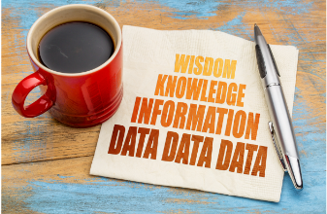
DIKW- From Raw Data to Valuable Decisions
DIKW Model
A Four-Layer Model
D – Data
I – Information
K – Knowledge
W -- Wisdom

Slide 22
DIKW – Cont’d
Data:
  Example – 90, 1.6, Risk, Hypertension, AKTH, NSA, NMA, Kano, Seminar, Week, Resident
Information
  70kg, 1.6m, risk of hypertension, AKTH health facility, NSA organization, Weekly Seminar, Resident Doctor
Knowledge
  His weight is 90kg and his height is 1.6m. His BMI is 35.2kg/m2 and he is thus at an increased risk of some medical conditions.
Wisdom
  He should therefore try and reduce his weight because of attendant health risks

Slide 23
Types of Data used in AI
Structured Data
    Quantitative, organized in rows and columns as in spreadsheets.
    Examples of structured data includes names, dates, addresses, credit card numbers, stock information.
Unstructured Data
    Also known as dark data. Typically, qualitative data such as medical records, images, texts, audio, etc.
    This makes up over 80% of all modern data generated globally.
    It cannot be processed and analyzed by conventional data tools and methods. Unstructured data lacks any built-in organization, or structure.

Slide 24
Types of Data – cont’d
Semi-structured Data
    Combines features of both structured and semi-structured data.
    It uses metadata to identify specific data characteristics and scale data into records and preset fields. Examples: JSON files, XML code, and emails (which have distinct "To", "From", and "Date" headers but open text bodies).
    Metadata ultimately enables semi-structured data to be better cataloged, searched, and analyzed than unstructured data.
    Another example of semi-structured data is a video on a social media site. The video by itself is unstructured data, but a video typically has text for the internet to easily categorize that information, such as through a hashtag to identify a location.

Slide 25
Data Storage Stages and Data Pipelines
Data storage stages represent the structured pipeline that raw data travels through, from its creation on an app or sensor to its final consumption by business analysts and AI models.
This pipeline is organized into distinct stages to handle different sizes, formats, and speeds of data.
The three core storage architectures used to manage these stages are
Data Lakes,
Data Warehouses, and
Data Lakehouses – the modern hybrid

Slide 26
Data Storage Stages and Data Pipelines – cont’d
Data Lake
Centralized repository designed to store vast amounts of raw, unformatted data in its native format. It operates on a principle called Schema-on-Read
Stores 100% unstructured, semi-structured, and structured data (e.g., raw logs, tweets, MP4 videos, PDF medical files, JSON payloads).
Data Warehouse
Highly structured, relational database optimized exclusively for analytical querying and business intelligence. It operates on a principle called Schema-on-Write
Stores exclusively highly cleaned, heavily filtered structured data.
Data Lakehouse
A Lakehouse applies the structural controls, ACID transaction reliability, and SQL querying speeds of a Data Warehouse directly on top of the cheap, raw storage files of a Data Lake.

Slide 27
AI & ML

Slide 28
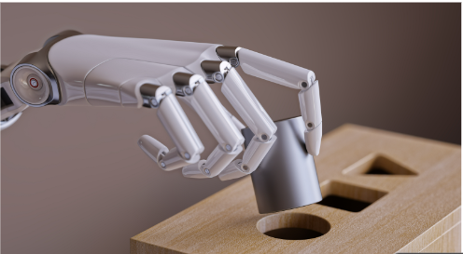
Artificial Intelligence and Machine Learning
AI is impacting a lot of domains ranging from medicine to marketing, education, HR, art etc.
From self-driving cars to believable fakes, AI and ML have implications for the future of the society and how we function.
In recent years, there has been so much research on AI and a lot of educational resources on AI.

Slide 29
AI & ML – Cont’d
Considering its recent popularity, it would seem like AI is a very new field that just emerged few years ago.
However, its origin dates back to the middle of the 20th century.
In 1950, Alan Turing, one of the fathers of AI is reported to have asked “Can Machines Think?”
He also stated that a computer would deserve to be called “intelligent” if it can deceive a human by behaving as one.

Slide 30
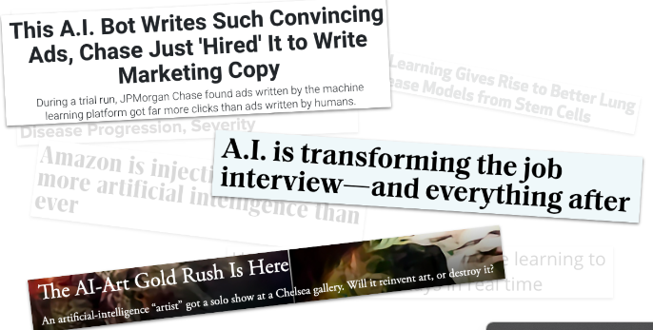
AI & ML – Cont’d
Machine Intelligence is said to be the last invention that humanity will ever need to make.
AI originated as a new branch of knowledge within computer science.

Slide 31
AI & ML – Cont’d
A study by McKinsey & company revealed that AI is on its way to automate about 30% of hours currently worked in the US economy and will also bring about 12 million job transitions.
The impact of AI goes beyond just mere statistics.
In the world today, data-driven insights is no longer a luxury but a necessity.

Slide 32
McKinsey Global Institute Report: “A new future of work: The race to deploy AI and raise skills”
Targeted Roles: Displacements are heavily concentrated in administrative support, customer service, sales, and food services where routine data processing and repetitive tasks are common.
Growth Sectors: Conversely, labor demand will surge for healthcare practitioners, STEM professionals, and high-skill managers.
The Skills Gap: Workers will need significant retraining, shifting away from physical or manual skills toward advanced technological, social, and emotional capabilities

Slide 33
AI & ML – Cont’d
AI is projected to contribute about 15 trillion dollars to the global economy by the year 2030!!!
The global AI healthcare market is expected to have an annual growth rate of 37% from 2022 to 2030 when it will have a projected worth of about 188 billion dollars!!!

Slide 34
Artificial Intelligence
Nowadays, when people refer to AI, they’re most likely referring to ML.
AI is a huge set of tools for making computers behave intelligently.
ML is the most common subset of AI. ML model is a statistical representation of a real-world process based on data.
AI has been pivotal to the success of companies ranging from web search (e.g., Google), content recommendations (e.g., Netflix), product recommendations (e.g., Amazon), targeted advertising (e.g., Facebook), and autonomous vehicles (e.g., Tesla).

Slide 35
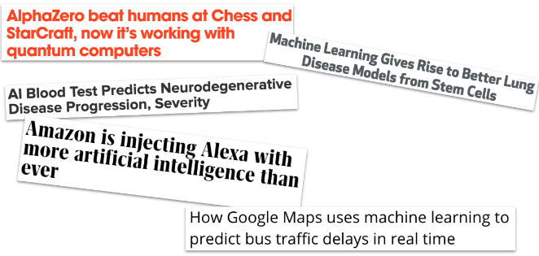
AI – cont’d
Some applications of AI in the field of medical sciences include:
  Matching patient symptoms to appropriate physician
  Patient diagnosis and prognosis
  Drug discovery
  Bot assistant that can translate languages, transcribe notes, and organize images and files.

Slide 36
Definition of AI
The science of building machines that learn to mimic reasoning, decision-making and in general human-like intelligence to solve a problem.
The EU Commission defines AI as systems that perceive their environment, collect data, and interpret it to reason over knowledge inferred, make decisions and take the best course of action to achieve a goal.

Slide 37
Machine Learning
ML is a set of tools for making inferences and predictions from data.
ML methods are taken primarily from statistics and computer science.
ML gives computers the ability to learn without being explicitly programmed to do so, i.e. without step-by-step instructions.
Basically ML learns patterns from existing data and applies it to new data, e.g. in spam email detection. ML needs high quality data.
DS is about discovering and communicating insights from data.
Notes:
Prediction is about the outcome of future events, e.g., will someone develop hypertension after the age of 40yrs?
Inference is more vague because it is about drawing insights, e.g., we can infer the cause of events and behaviors e.g., why someone develop hypertension after age 40yrs.

Slide 38
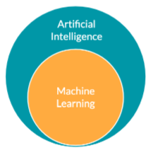
Definition of ML
ML is the ability of computer software to learn from existing data by itself without being explicitly programmed to do so, by identifying patterns within the data and make predictions or inferences from the data.

Slide 39
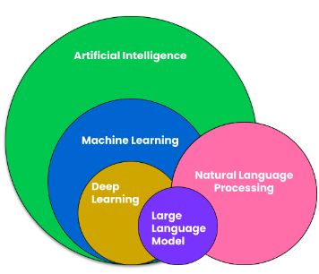
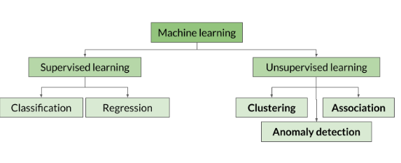
Types of ML
There are majorly three types of ML
  Supervised ML
  Unsupervised ML
  Reinforcement Learning
Notes:
Semi-Supervised Machine Learning. In the real world, human data labeling is incredibly expensive and time-consuming (e.g., paying doctors to manually review 10,000 X-rays).

Slide 40
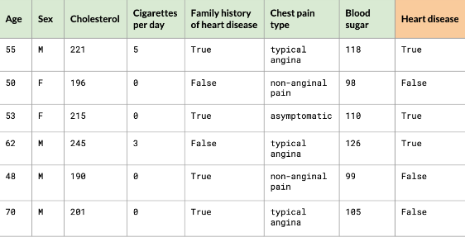
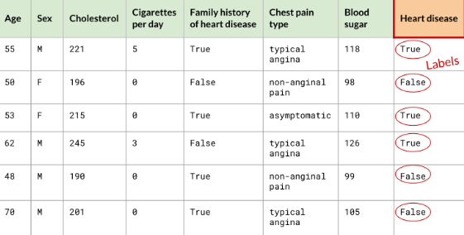
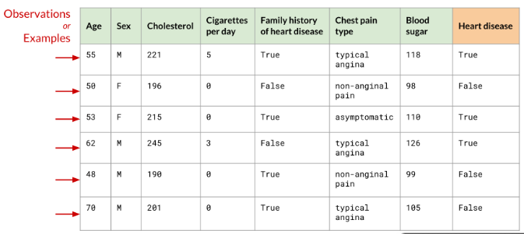
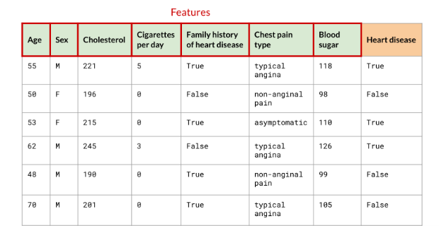
ML – cont’d

Slide 41

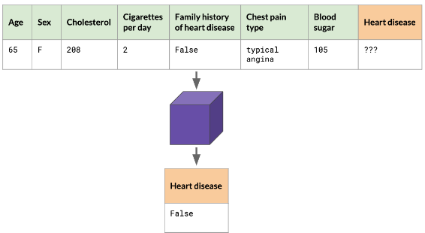
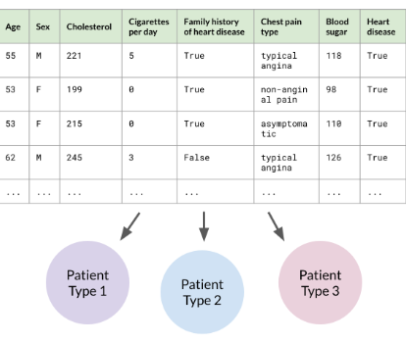
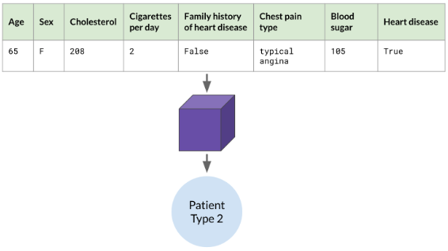
ML – cont’d

Slide 42
ML Workflow
Data Preparation
    Data collection
    Data cleaning
    Feature Engineering
    Split the data
Modelling
    Hyperparameter tuning
    Train your models
    Make predictions
    Assess model performance

Slide 43
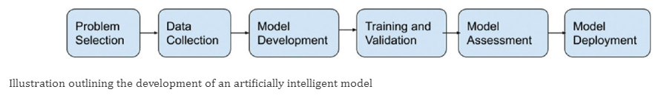
ML Workflow – cont’d
Deployment
    Deploy the model
    Monitor model performance
    Improve your model

Slide 44
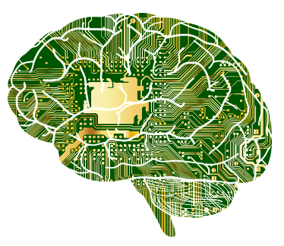
Deep Learning
Also known as Neural Networks. Neurons (nodes) are the basic units of neural networks.
It is a special area of ML that requires more data and especially suited for when inputs are texts or images.
Neural Networks with many neurons are referred to as Deep Learning.
They are suited for solving complex problems

Slide 45
When to use Deep Learning
Lots of data
Access to processing power
Lack of domain knowledge
Complex problems
    Computer vision
    Natural Language Processing (NLP)

Slide 46
Computer Vision
Goal is to help computers see and understand the contents of digital images and videos e.g.
    Self-driving cars
    Facial recognition
    Automatic detection of tumors in CT scans
    Deep fake

Slide 47
Natural Language Processing (NLP)
This is the ability of computers to understand human language.
Applications include:
    Language translation
    Chatbots
    Personal Assistants
    Sentiment Analysis

Slide 48
How does Machine Learning Approach a Problem
Deterministic
    This is basically binary thinking: on or off, yes or no.
    This is the essence of a computer program.
    The answer is either true or false, not a confidence value.
Probabilistic
    ML never says “YES” or “NO”.
    A Machine Learning system doesn’t say, “This is the best treatment for this cancer.”
    It says something like, “I am 84% confident that this treatment will result in remission in the shortest time.”

Slide 49
How does Machine Learning Approach a Problem – cont’d
If machine learning offers only probabilities, who makes the final decision?
This can literally be a life-and-death question.
Suppose your patient has a serious disease and you, as his doctor, offer him a choice.
Would he want you, his doctor, to prescribe his treatment, or would he want the treatment that a machine learning system determines is most likely to succeed?

Slide 50
Types of AI
Artificial Narrow Intelligence (ANI)
Which has a narrow range of abilities
Artificial General Intelligence (AGI)
Which is on par with human capabilities
Artificial Super Intelligence (ASI)
Which is more capable than a human.

Slide 51
Artificial Narrow Intelligence (ANI) vs. Artificial General Intelligence (AGI)
ANI is where we are now while AGI is where we aspire to be.
AGI refers to systems that equal or exceed average human intelligence, being able to solve a variety of tasks intelligently.
This is in contrast to ANI systems that are good at solving one or a few very specific tasks they have been designed for.

Slide 52
ANI vs. AGI – cont’d
Real AGI does not actually exist – yet!!!
There are however examples of AI systems that are close to emulating the human intelligence - voice assistants, face recognition, industrial robots etc. to self-driving cars, the AlphaGo system and Generative AI with LLMs like GPT.
We are in a transition phase referred to as Emerging AGI

Slide 53
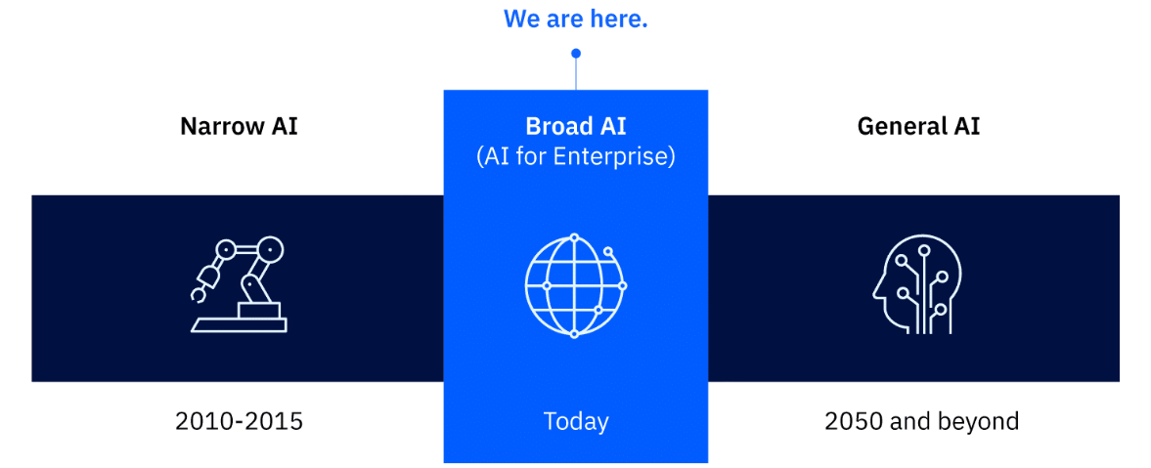
Levels of AI

Slide 55
Predictive AI vs. Generative AI
Both are two of the various broad classes of AI, each with different range of uses and applications
Predictive AI, as the name implies, is used to make predictions about the future based on historical data or used to make inferences such as classifying data examples based on previously classified (labelled) examples.
Generative AI, on the other hand, is widely used for creating new content such as text, image, sound, video generation based on the properties and patterns of existing content.

Slide 56
Abilities and Limitations of AI
We need to know what AI can and cannot do.
Amongst others, AI can:
    Make predictions and inference using ML
    Recognize patterns in data e.g. in clustering, anomaly detection and Generative AI
    Optimize and automate processes
Notes:
Predictions are about forecasting somethings yet to happen such as weather forecasting.
Inferences determine a target output based on a set of inputs (predictors) e.g suggesting a movie or book to you based on your preferences

Slide 57
Limitations of AI
Liability Ambiguity: The legal framework remains unclear on who is responsible when an AI-driven recommendation harms a patient - the developer, the hospital, or the physician.
Conversational AI solutions like chatbots are very good at answering human enquiries but they cannot mimic critical aspects in social interactions such as emotional intelligence and empathy.
Hallucination & Data Bias
Sufficiency and Data Quality (Garbage In, Garbage Out)
The "Black Box" Problem (Explainability)

Slide 58
Pattern Recognition
This is a general term that refers to the analysis of data to find patterns therein, and using this to make informed decisions.
Some examples of common use of pattern recognition is in:
    Predictions and Inferences
    Clustering
    Anomaly detection
    Generative AI
    Optimization
    Improving efficiency in Automation

Slide 59
Pattern Recognition – Cont’d
Prediction is about forecasting events yet to happen such as weather forecast.
Inference is about determining a target output based on a set of inputs (predictors) such as suggesting a book to read or movie to watch based on your preferences as a customer.
Clustering is used for discovery of data with similar characteristics with application in customer segmentation.

Slide 60
Pattern Recognition – Cont’d
Anomaly detection is used in healthcare to discover cancers, finance, and security to discover fraudulent transactions.
Generative AI, in which AI is used to generate new text, image, sound, and video data from existing data patterns
Generative AI can produce outputs in the same medium in two ways:
    In the same medium in which it was prompted e.g. text-to-text
    In a different medium from the given prompt e.g. text-to-image or image-to-video

Slide 61
Pattern Recognition – Cont’d
Generative AI can be run using various models which use different mechanisms to train the Ai such as:
Generative Adversarial Networks (GANs),
Transformers, and
Variational AutoEncoders (VAEs).
Popular generative AI interfaces include ChatGPT, DeepSeek, Claude, Bard, DALL-E, Midjourney, and DeepMinds
Notes:
Generative adversarial networks (GANs) are a type of deep learning model that consists of two neural networks: a generator and a discriminator. The generator creates new data samples that are similar to the training data, while the discriminator tries to distinguish between the real and fake data. The two networks are trained together in a game-like setting, where the generator tries to fool the discriminator and the discriminator tries to correctly identify the real data.

Slide 62
Applications of AI in Medicine – cont’d
AI in medicine involves the use of ML models to search medical data and uncover insights to help improve health outcomes and patient experiences.
AI can help to support clinical decision-making in medicine thus helping doctors to make more informed diagnosis and treatment decisions.
AI has the potential to make medical diagnoses more accurate, efficient and cost-effective.
The Covid-19 pandemic brought to fore the crucial role AI can play in medical practice.

Slide 63
Classification of AI in Medical Practice
Applications of AI in medicine can be broadly classified into three categories:
Patient-oriented AI
Clinician-oriented AI and
Administrative and Operational-oriented AI.

Slide 64
Classification of AI in Medical Practice – cont’d
AI in medicine can also be divided into:
Virtual – This ranges from applications such as electronic health record systems to neural network-based guidance in treatment decisions.
Physical – This part deals with robots assisting in performing surgeries, intelligent prostheses for handicapped people, and elderly care.

Slide 65
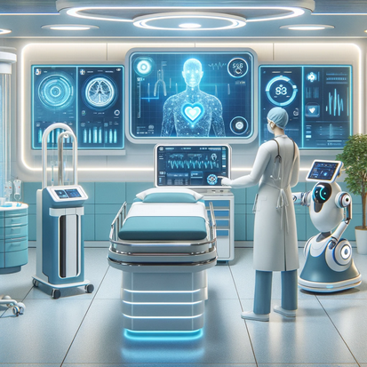
Applications of AI in Health Care
The global AI healthcare market is projected to be worth nearly $188 billion by 2030, with a compound annual growth rate of 37% from 2022 to 2030.
AI systems in healthcare have the potential to improve quality, safety, optimize workflow, improve efficiency and patient satisfaction

Slide 66
Applications – cont’d
There are many different algorithms that can learn from data.
Most applications of AI in medicine read in data input either as:
    Numerical (such as heart rate or blood pressure) or
    Image-based (such as MRI scans or Images of Biopsy Tissue Samples)

Slide 67
AI in Medical Education
The education and training of medical students will be limited if they only study medical books and specimens.
AI technology use in medical students education is now richer and more colorful.
AI-based problem based learning and AI simulation based surgical training system has created a new educational tool
This has improved student's learning and understanding, thus enhancing their knowledge of clinical diseases

Slide 68
How are some of the Health Data Gathered
Electronic Health Record
The Internet of Things (IoT) refers to a network of interconnected physical devices, objects, vehicles etc embedded with sensors, software and collecting and exchanging data through network connectivity.
The IoT devices can communicate with each other and with humans through the internet network. This allows for remote monitoring, control and automation of various processes.
IoT devices in healthcare have become very useful tools in the 21st century with a projected market for IoT devices reaching about 100 billion USD by 2026

Slide 69
Examples of IoT Devices in Healthcare
Some examples of IoT devices in healthcare industry include:
    Remote patient Monitoring (RPM)
    Glucose monitoring devices
    Heart rate monitoring
    Hand hygiene monitoring
    Depression or mood monitoring
    Parkinson disease monitoring
    Connected inhalers
    Ingestible sensors
    Connected contact lenses
    Robotic surgeries

Slide 70
Methods of Machine Learning

Slide 71
Supervised Learning
Supervised learning is about providing AI with enough examples to make accurate predictions.
All supervised learning algorithms need labeled data. Labeled data is data that is grouped into samples that are tagged with one or more labels.
Applying supervised learning requires you to tell your model:
    What the key characteristics of a thing are, also called features
    What the thing actually is

Slide 72
Supervised Learning – cont’d
In supervised learning, humans give an AI system what’s called structured data.
This is a set of facts and figures arranged into neat, labeled categories, the way you might put weather information into a table.
The machine will never give this result with absolute confidence.
Instead, the system will give a confidence value to indicate, for example, that it might predict with 85% certainty that its answer is correct.

Slide 73
Supervised Learning – cont’d
The more data the system ingests, the higher its accuracy will be.
For example, the information might be drawings and photos of animals, some of which are dogs and are labeled “dog”.
The machine will learn by identifying a pattern for “dog”.
When the machine sees a new dog photo and is asked, “What is this?”, it will respond, “dog”, with high accuracy.
This is known as a classification problem.

Slide 74
Unsupervised Learning
In unsupervised learning, a person feeds a machine a large amount of information, asks a question, and then the machine is left to figure out how to answer the question by itself.
For example, the machine might be fed many photos and articles about dogs.
It will classify and cluster information about all of them.
When shown a new photo of a dog, the machine can identify the photo as a dog, with reasonable accuracy.

Slide 75
Unsupervised Learning – cont’d
Unsupervised learning occurs when the algorithm is not given a specific “wrong” or “right” outcome.
Instead, the algorithm is given unlabeled data.
Unsupervised learning is helpful when you don't know how to classify data.

Slide 76
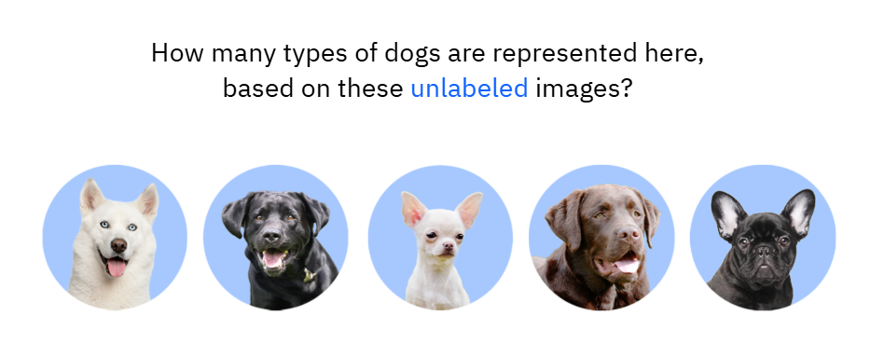
Unsupervised Learning – cont’d

Slide 77
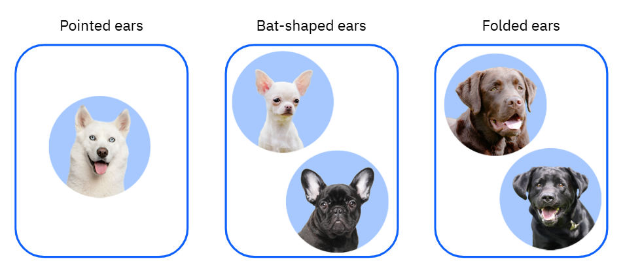
Based on Ear Shape

Slide 78
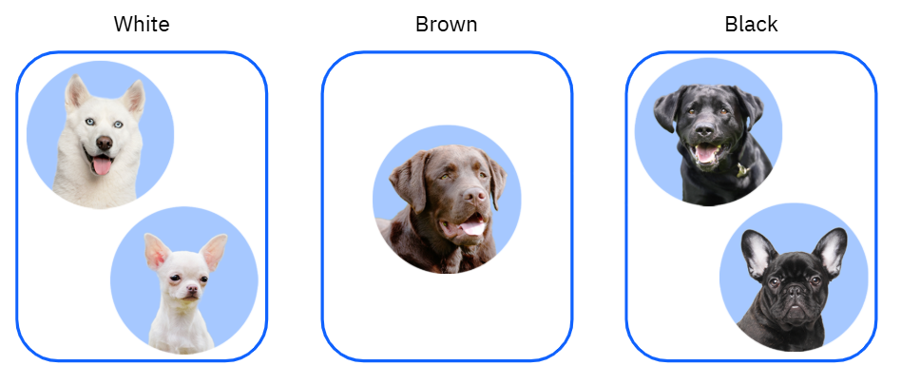
Based on Color

Slide 79
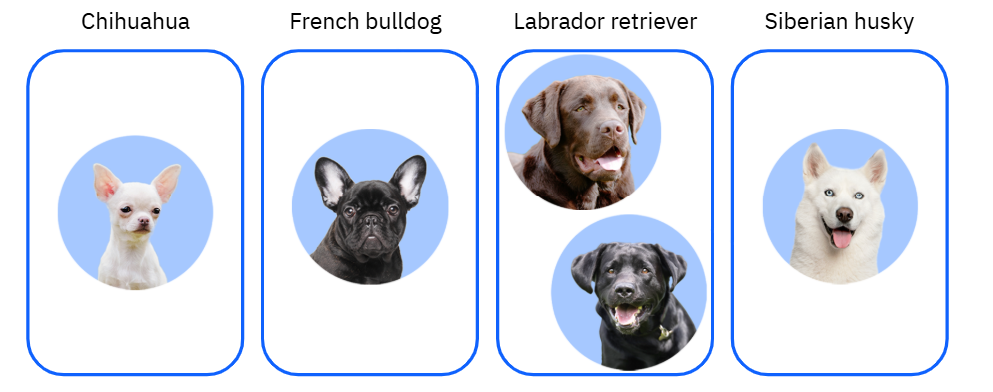
Based on Breeds

Slide 80
Reinforcement Learning
Reinforcement learning is a machine learning model similar to supervised learning, but the algorithm isn’t trained using sample data.
This model learns as it goes by using trial and error.
A sequence of successful outcomes is reinforced to develop the best recommendation for a given problem.
The foundation of reinforcement learning is rewarding the “right” behavior and punishing the “wrong” behavior.

Slide 81
Reinforcement Learning – cont’d
What does it mean to "reward" a machine?
Rewarding a machine means that you give your agent positive reinforcement for performing the "right" thing and negative reinforcement for performing the "wrong" things.

Slide 82
Reinforcement Learning – cont’d
As a machine learns through trial and error, it tries a prediction, then compares it with data in its corpus.
    Each time the comparison is positive, the machine receives positive numerical feedback, or a reward.
    Each time the comparison is negative, the machine receives negative numerical feedback, or a penalty.
Over time, a machine’s predictions will grow to be more accurate.
It accomplishes this automatically based on feedback, rather than through human intervention.

Slide 83

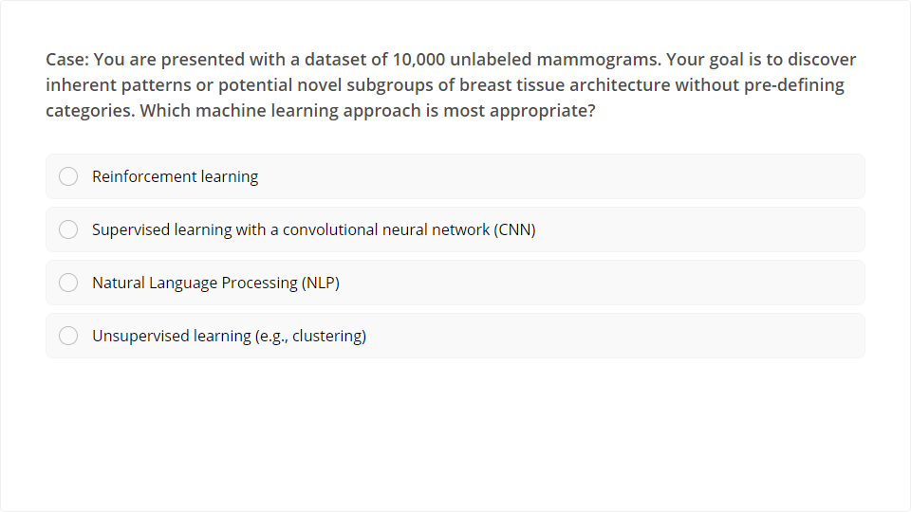
Quiz
Click the Quiz button to edit this object

Slide 84
Classical Machine Learning

Slide 85
Classical ML
Classical machine learning began in the 1950s. AI systems learned by ingesting data and getting better at recognizing patterns.
Like all machine learning, the classical form depends on algorithms.
Recall that algorithms are mathematical expressions that output a result.
Classical machine learning uses a small number of algorithms in a relatively simple arrangement.

Slide 86
Classical ML – cont’d
Sometimes machine learning algorithms are binary, which means that they output one of only two values.
Typical binary results might be a 1 or a 0, a YES or a NO, and a TRUE or a FALSE.
Three typical algorithms that are used in classical computing:
    Decision tree
    Linear regression
    Logistic regression

Slide 87
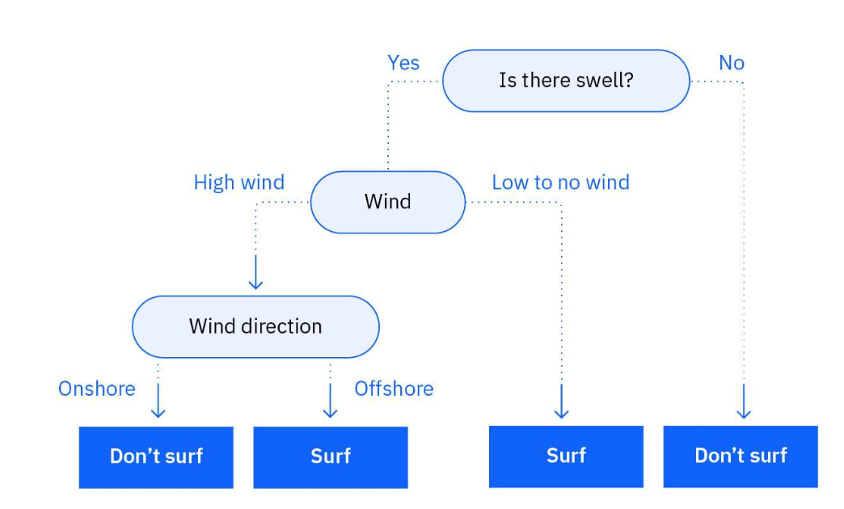
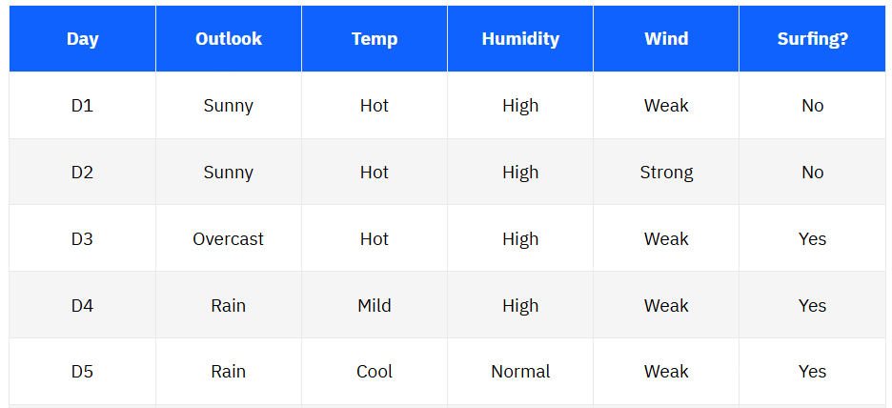
Decision Trees

Slide 88
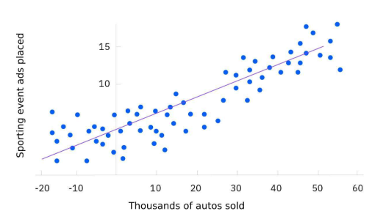
Linear Regression
Linear regression is another type of algorithm. It relates to data that might be graphed as a straight line.
For example, a business might believe that more advertising spending leads to better sales.
This could be graphed as a series of dots that form a rising straight line, as depicted here.

Slide 89
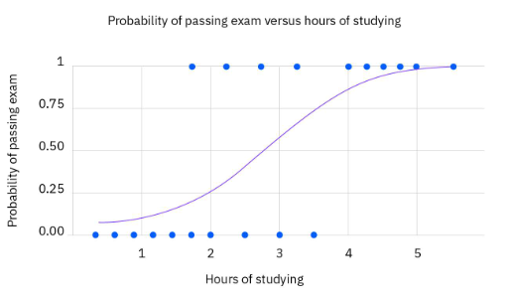
Logistic Regression
In some situations, a relationship does not fall in a straight line. Sometimes a system uses values that require a specific, limited kind of outcome, such as something between 0 and 1 (or NO and YES).
In this situation, a graph can form what’s called a sigmoid function, or an S-shaped curve, as shown in the accompanying example.
For any set of variables, the outcome (which is a point on the S-curve) falls between 0 and 1.

Slide 90
Comparing Linear and Logistic Regressions
Linear and logistic regressions are useful in the following ways:
    A linear regression answers a question such as “If this increases by X, how much will Y increase?”
    A logistic regression answers a question such as “If this increases by X, will the value of Y be closer to 0 or 1?”

Slide 91
Why Classical ML
Classical machine learning can be outperformed, at some tasks, by newer methods that are part of the deep learning ecosystem.
But there are still reasons to use classical machine learning.
These include:
    Work with structured data
    Lower expense to operate
    Easier to interpret

Slide 92
Deep Learning

Slide 93
Neural Networks
Neural networks are inspired by human brain cells.
Today, machine learning has evolved into a collection of powerful applications called the deep learning ecosystem.
The foundation for many applications is called a neural network.
A neural network uses electronic circuitry inspired by the way neurons communicate in the human brain.

Slide 94
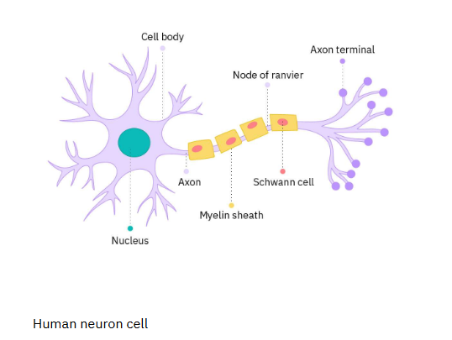
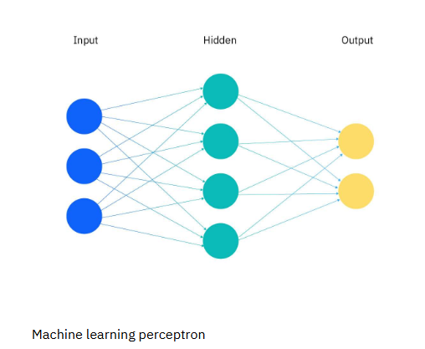
Neural Networks – cont’d

Slide 95
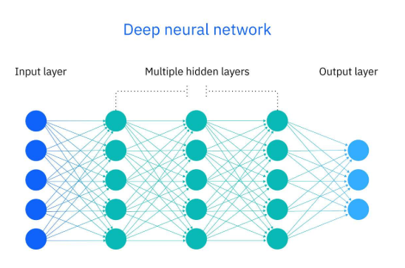
Neural Networks – cont’d
The hidden layers in a neural network resemble, as a group, the long cell body that connects dendrites to axons within a human brain cell. Those hidden layers contain nodes.
Each node runs an algorithm and bits of additional code to test and adjust its result. When the value reaches a certain threshold, the node “fires”.

Slide 96
Neural Networks – cont’d
Researchers estimate that a human brain has about 100 billion neurons, each one connected to up to 10,000 other neurons.
In a neural network, a building block, called a perceptron, acts as the equivalent of a single neuron.
A perceptron has an input layer, one or more hidden layers, and an output layer.
A signal enters the input layer and the hidden layers run algorithms on the signal. Then, the result is passed to the output layer.

Slide 97
Neural Networks – cont’d
The hidden layers in a neural network resemble, as a group, the long cell body that connects dendrites to axons within a human brain cell. Those hidden layers contain nodes.
Each node runs an algorithm and bits of additional code to test and adjust its result.
When the value reaches a certain threshold, the node “fires”.
Note: A node often uses a sigmoid function to determine whether or not to “fire”. As explained previously, a sigmoid function can generate a binary answer, such as, YES or NO.

Slide 98
Neural Networks – cont’d
The binary answer tells the node whether or not to fire. You can think of the threshold as a hurdle a solution must jump over to give a result of YES.
If there are other nodes connected to the node, they are activated when the signal reaches them. If the other nodes reach their own thresholds, then they fire.
The signal cascades down through the hidden layers in a way that’s somewhat similar to how a signal passes down the body of a human brain cell.

Slide 99
How Does a Neural Network Learn?
The operation of a neural network is pure mathematics. The network isn’t “thinking”; it is calculating.
But it’s using those calculations to create an output that humans can interpret as an answer or a recommendation.
How does a neural network learn - by continuously adjusting itself, in a process that humans refer to as trial and error.
Once a neural network has ingested or already learned a certain amount of data, it stores the data in its “body of information”, called its corpus.

Slide 100
How Does a Neural Network Learn? – cont’d
In order to learn, the neural network constantly tests new data or the results of its calculation against its corpus.
If the network determines that the new data or results don’t match the patterns it has already established, it modifies those patterns for a better fit.
Sometimes, to improve a single match, the network tests hundreds or thousands of modifications very rapidly and makes adjustments.
Then, the network tests to determine if the match is improving. So, step by step, the machine learns.

Slide 101
How Does a Neural Network Learn? – cont’d
Many AI systems output a confidence value along with an answer or prediction.
For example, a system predicting effective treatments for a cancer patient might output two or three suggested approaches, along with a measure of how confident it is that each treatment might work.
This reflects how the system reaches those decisions. The system also leaves the final decision to the doctor who knows the patient.
Deep Learning systems require high computing power to perform.

Slide 102
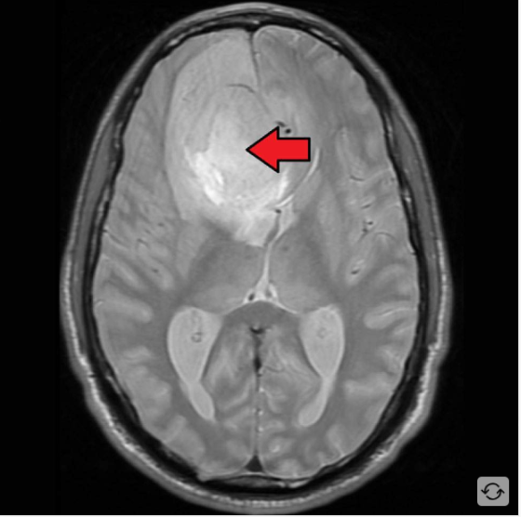
How Does a Neural Network Learn? – cont’d
Cancer treatment
Radiologists can use DNNs to identify variations in MRI images that are otherwise invisible to the human eye. Radiologists can receive early warnings of potentially treatable cancers.

Slide 103
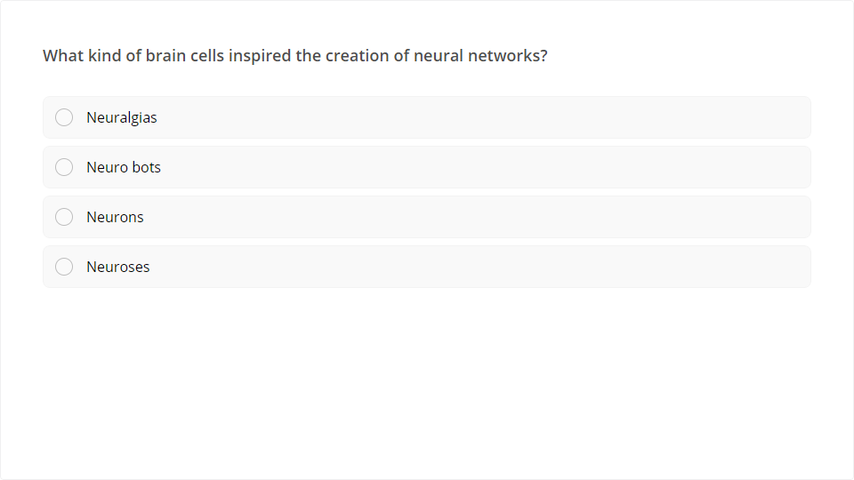
Quiz
Click the Quiz button to edit this object

Slide 104
Generative AI

Slide 105
Generative AI
Generative artificial intelligence (AI) is a powerful and exciting type of AI that generates new, original content, such as images, music, videos, data, code, responses to questions, and a whole lot more.
Generative AI is a type of artificial intelligence that creates new, original content that people have never seen before.
  Most AI systems are discriminative AI models, which predict and classify data.
  In contrast, generative AI models are a type of deep learning AI system that uses algorithms to generate content based on a submitted prompt, thus the name of generative AI.

Slide 106
Generative AI – cont’d
For example, a discriminative model could tell a bicycle from a truck and a generative model could generate a new image that looks like a bicycle.
So, generative AI’s distinction from other AI systems is its ability to produce content that is new and considered creative, such as images, videos, music, synthetic data, essays, answers to questions, and more.

Slide 107
Types of Generative AI Models
There are three primary types of generative AI models:
  Variational AutoEncoder (VAE)
  Generative Adversarial Network (GAN)
  Autoregressive
Notes:
Think of variational autoencoder (VAE) models as a skilled artist who can look at a painting, quickly sketch a simplified version of it, and then recreate a new painting using only that simplified sketch as a reference. The artist is capturing the essential elements of the painting and then using them to create a new work of art.
VAEs use a similar process. The "encoder" network compresses the input data into a lower-dimensional representation and the "decoder" network reconstructs the original data from this compressed representation. This allows VAEs to capture the underlying structure and patterns in the data, which can then generate new, similar data.
Think of a generative adversarial network (GAN) model as a competition between a skilled forger (the generator) and a talented art critic (the discriminator). The forger creates fake paintings, while the critic tries to determine whether each painting is genuine or a forgery. As the forger improves their technique, the critic becomes more discerning, and this cycle continues until the forger can create near-perfect forgeries.
In GANs, the generator creates new data, while the discriminator evaluates the quality of the generated data. The generator tries to create data that is realistic enough to fool the discriminator, while the discriminator learns to better distinguish between real and generated data. This competition leads to the generator creating increasingly realistic content.
Imagine an autoregressive model as a skilled storyteller who listens to the beginning of a story and then continues it by predicting what comes next based on the words and events that have occurred so far. The storyteller uses their knowledge of language, grammar, and storytelling conventions to create a coherent and engaging continuation of the story.
Autoregressive models generate new content by predicting the next element in a sequence based on the previous elements. They are particularly well-suited for generating text because they can model the conditional probabilities of words and characters in a sentence.

Slide 108
Use of GenAI in Healthcare
In healthcare, generative AI can help improve disease diagnosis, medical imaging, and personalized medicine.
One application of generative AI is in the generation of synthetic medical images, which can train machine learning algorithms and improve disease diagnosis.
For example, generative AI can generate synthetic medical images of rare diseases, which can be difficult to obtain in real life.

Slide 109
Use of GenAI in Healthcare – cont’d
Another application of generative AI in healthcare is the creation of medical simulations. These simulations can help train healthcare professionals and reduce medical errors.
By generating synthetic patient data, generative AI can also train predictive models and improve personalized medicine.
Generative AI has the potential to transform healthcare by enabling the creation of realistic medical simulations, improving disease diagnosis, and enhancing personalized medicine.

Slide 110
Use of GenAI in Healthcare – cont’d
PathAI uses GenAI to improve the accuracy of disease diagnosis through the analysis of medical images.
Specifically, PathAI has developed a deep learning algorithm that can accurately detect cancer cells in digital pathology images.
This algorithm was trained on a large dataset of annotated pathology images using a VAE generative model.

Slide 111
Use of GenAI in Healthcare – cont’d
The VAE learned the underlying structure of the pathology images to generate synthetic images that were like the real images in the training set.
By training their algorithm on both real and synthetic images, PathAI was able to improve the accuracy of their cancer detection algorithm.
This technology has the potential to improve the accuracy and speed of cancer diagnosis, to ultimately improve patient outcomes.

Slide 112
Natural Language Processing (NLP) and Computer Vision (CV)

Slide 113
NLP
Every day, computers help you by understanding things they hear and see.
Your phone responds to your verbal questions and commands.
Understanding human language is difficult, even for people who have grown up with it.
Machines require systems that research scientists call Natural Language Processing, or NLP, to understand human language.

Slide 114
NLP – cont’d
A chatbot uses NLP to interact with customers or patients.
A chatbot works with small data, and has both a frontend and backend.
The frontend of a chatbot is the messaging channel. The frontend interacts with the person who’s asking questions, both listening (or reading) and speaking (or presenting text).
The backend of a chatbot is where the hard work takes place. The backend operates application logic and has enough memory to remember earlier parts of a conversation as dialog continues.

Slide 115
LLMs
LLM (Large Language Model), a highly powerful tool within the NLP toolkit is a specific, and modern type of machine learning model trained on massive amounts of text data using deep learning architectures (primarily Transformers).
Large Language Models (LLMs) are highly advanced deep learning programs designed to understand, process, and generate human-like text.
They represent the current state-of-the-art in Artificial Intelligence and Machine Learning for handling natural language.
Many of the popular text-based GenAI apps rely on LLMs.

Slide 116
Convolutional Neural Networks (CNN)
A Convolutional Neural Network (CNN) is a specialized type of deep learning algorithm mainly designed for tasks that necessitate object recognition, including image classification, detection, and segmentation.
With a convolutional neural network (CNN), an AI system can analyze images.
With a generative adversarial network (GAN), an AI system can create new drawings and photos.
A convolutional neural network, or CNN, makes it possible for visual recognition systems to identify things in an image, as in facial recognition.

Slide 117
CNN – cont’d
In a CNN, two small groups of pixels that overlap each other are compared mathematically to get a value.
AI can use thousands of these small comparisons to identify individual parts of an image, then compare them to images in its corpus.
From this, AI can put together an overall identification, without being overwhelmed.

Slide 118
Retrieval Augmented Generation (RAG)
RAG (Retrieval-Augmented Generation) is an AI technique that gives large language models (LLMs) the ability to pull fresh, accurate information from external databases or documents before answering a question.
Think of it like taking an "open-book test“.
The AI is no longer forced to rely only on its static, pre-trained memory.

Slide 119
Why use RAG
Privacy, confidentiality, rapidly changing information, and security are important.
Standard AI models have two major flaws:
They are cut off from real-time data, and
They sometimes make things up (hallucinate).
RAG solves this by:
Grounding: Forcing the AI to use specific, provided facts and lower hallucinations.
No Retraining: Allowing you to give the AI private company documents or live feeds without paying to retrain the model.
Transparency: Allowing the AI to cite exact sources.

Slide 120
Future of AI in Medical Practice

Slide 121
The Future of AI in Medical Practice
Recent developments in technology and AI systems indicate that AI is poised to revolutionalize many sectors, including the healthcare system and the traditional practice of medicine.
AI has a bright and promising future. Medical doctors need to early key into the opportunities that are being and will be provided by AI in the healthcare system.
AI has huge potentials in the healthcare delivery system and doctors as leaders of healthcare team should be prepared to ride with the tide of AI

Slide 122
The Future of AI in Medical Practice – cont’d
In Nigeria, doctors need to embrace AI and pave the way for groundbreaking innovations in healthcare services delivery across the country, given our local peculiarities.
In most cases, the demand for medical experts far exceeds the available supply
AI application cuts across various specialties of medical practice including but not limited to: public health, radiology, ophthalmology, internal medicine, laboratory medicine, surgery, etc.
Given the global impact of AI/ML, it is important for AI education to be a part of the Nigerian school curriculum for a range of domain experts.

Slide 123
The Future of AI in Medical Practice – cont’d
This is particularly true for the medical profession, where the cost of a wrong decision can be fatal.
A good understanding of all the nuances including how AI systems are designed and work is important because it can affect the accuracy of diagnoses and treatment recommendations.
For Nigeria doctors to tap into the huge potentials of AI in the healthcare system, we need to push for a paradigm shift from the traditional manual method of keeping medical records to the more reliable and scalable Electronic Medical Record (EMR) system, moreso because high quality data is the bedrock of a good, reliable and efficient AI system

Slide 124
The Future of AI in Medical Practice – cont’d
AI would be an integral part of medicine in the future.
Therefore, it is important embrace it, and to train the new generation of medical students and even resident doctors on the concepts and applicability of AI and how to function efficiently in a workspace alongside machines for better and improved healthcare service delivery to the masses.

Slide 125
Data Science Roles and Tools
Data Science isn’t a single job.
It involves four main jobs:
  Data Engineer
  Data Analyst
  Data Scientist
  Machine Learning Scientist

Slide 126
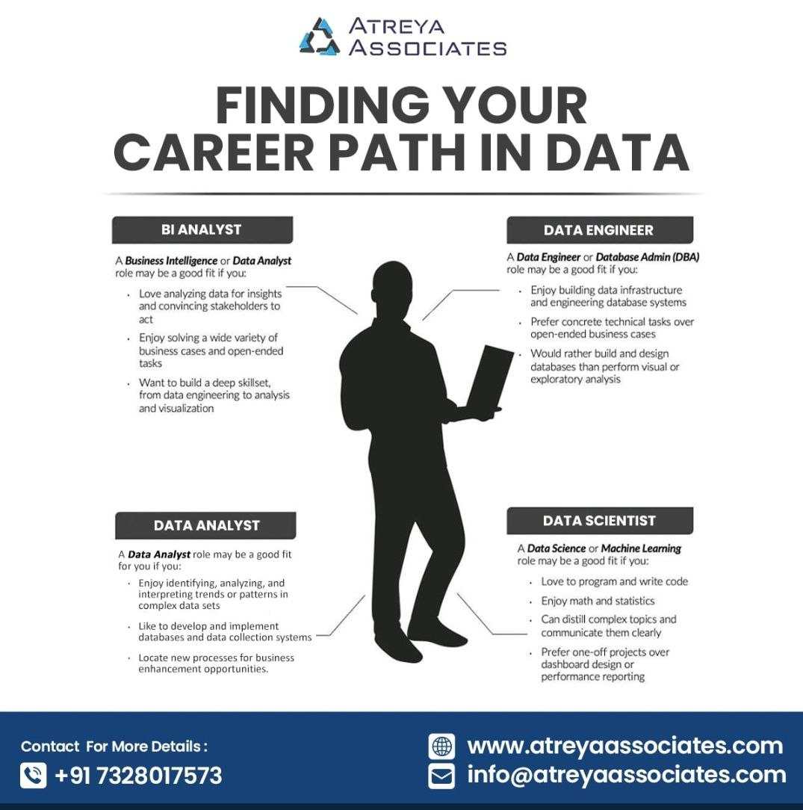
Data Career Paths

Slide 127

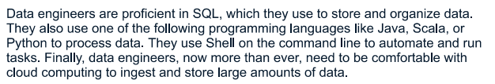
Data Engineer Roles and Tools

Slide 128
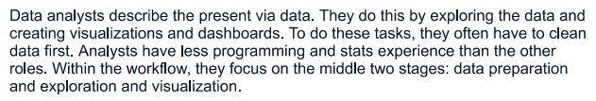

Data Analyst Roles and Tools

Slide 129


Data Scientist Roles and Tools

Slide 130


Machine Learning Scientist Role and Tools

Slide 131

General Tools

Slide 132

Comparison

Slide 133
AI Ethics

Slide 134
Responsible AI
Responsible AI is a set of practices that ensure AI systems are designed, used, and deployed in an ethical and legal way.
It's a broad concept that considers the ethical, social, and legal implications of AI throughout its entire lifecycle, from design to use.
The goal of responsible AI is to use AI in a safe, trustworthy, and ethical way.

Slide 135
Introduction to Ethics
Ethics is derived from the Greek word ethos, which translates to a way to live one's life.
Ethics is a branch of moral philosophy that studies the standards, values, morals, and principles for correct and wrong or fair and unfair behavior.
We all have an inherent sense of right and wrong, beyond just the obligation of complying with laws. Our choices are driven by this sense of right and wrong.

Slide 136
Introduction- Ethics and Legislations
Ethical principles and regulations are closely related.
The advent of AI is a potential game-changer for healthcare and regulatory processes will need to adapt.
Ethics are codes and guidelines, while laws may be used to enforce them.
Ethical standards go above legal requirements. What is legal may not always be ethical.
As with all regulation, a balance must be struck between protecting the public, clinicians and their services and promoting growth and innovation.
Notes:
Belmont Report guiding principles: Respect for persons (Informed Consent), Beneficence (Do No Harm), and Justice

Slide 137
Ethics and Legislation- Cont’d
Let's see the harms of ignoring ethics while only considering legal compliance.
  HeLa immortal cell lines in 1951
  Tuskegee syphilis research 1932 to 1972 –> Belmont Report on ethical guidelines of human subjects in biomedical and behavioral research
  Facebook social experiment on the newsfeed of about 700, 000 users in 2012
  Google’s employee’s access of 21 million patients data in 2019
In these cases, there were no major legal concerns.

Slide 138
Introduction: Why is Ethics Important
Not all decision-making is black and white.
Many situations have conflicting values that create a dilemma in making the right decision.
Examples:
  Do you report your best friend at work for committing a professional malpractice or not,
  Should pharmaceutical companies who spend hugely on drug discoveries for diseases charge a high premium for the drugs not withstanding those who need the cure but cannot afford the exorbitant costs
Notes:
For instance, your best friend at work violates a vital company policy.
Do you value your friendship more and ignore it, or do you uphold professional integrity and report them?
Pharmaceutical companies invest in innovation to find drug cures and expect a ROI.
However, this conflicts with the suffering of people who cannot afford them.
What's the right thing, and who should do it?
All our actions have consequences for ourselves and those around us. Aspects that benefit individual or single companies can damage and weaken entire economies and the future of our planet.

Slide 139
Why is Ethics Important- Cont’d
There are many ethical discussions and debates on the benefits and risks of new technologies that will influence our lives and may affect the future of the human species.
These discussions are about the responsible development, use, and control of ground-breaking innovative technologies like AI, stem cell use, IVF, etc.
Most of the advanced technologies that affect our everyday life are most likely data-driven - Data is the game changer.

Slide 140
Health Data and AI Ethics
Data has become one of the most valuable commodities of the 21st century, just like oil was in the 20th century.
  Oil and energy companies- most valuable companies in 20th century
  Data-driven companies- most valuable companies in 21st century
Given the incredible power of data, understanding its implications on individuals, business processes, and society is critical.
This need gave rise to a new branch of ethics known as data ethics.
The emergence of AI, which at it’s core, is largely dependent on data gave rise to another sub-branch known as AI ethics.

Slide 141
Health Data and AI Ethics- Cont’d
Digital and data-driven health and care technologies have the potential to deliver significant benefit to patients, clinicians, care-givers, health service users and the system as a whole.
There is a need to approach the adoption of these promising technologies responsibly and in a way that is conducive to public trust.
This paradigm shift won’t just affect those in data-related fields - every industry is going to undergo significant changes- from healthcare to E-commerce to Education to Data Security, etc., and all the way down to our daily lives.

Slide 142
AI Ethics and Legislations
In the midst of all these debates and marketing about what AI is or is not, what AI can do or can’t do, there is a more pressing concern we all need to be aware of - the ethical and legal implications of AI.
The recent surge in popularity and exponential development of artificial intelligence (AI) is beginning to make its mark on the healthcare system and many other systems.
As a result, questions around the ethical, legal and responsible use of AI is now a hot topic of debate amongst doctors, nurses, the general public, governments, industry, academia and other key stakeholders not only in healthcare system but in many other sectors as well.

Slide 143
AI Ethics and Legislations – Cont’d
These questions are far too important to be answered in hindsight.
Some of the questions begging for answers include:
  How do principles of medical ethics apply in this new world of technological innovation, particularly the AI revolution?
  To what extent can we rely on AI algorithms when it comes to matters of life and death or personal health and well-being?
  How do we ensure that these algorithms are used for the intended purposes?

Slide 144
AI Ethics and Legislations – Cont’d
  How do we ensure that AI does not inadvertently discriminate against specific cultures, age groups, gender, race, minorities, or other groups, thereby perpetuating inequalities in access and quality of care?
  Do patients have a right to know how much AI is used in their care?
  Do they also have a right to decline having AI involved in their care?
  I will attempt to highlight practical examples with thought-provoking questions about some of the ethical and legal implications of AI in healthcare.

Slide 145
AI Ethics and Legislations – Cont’d
I will also attempt to analyze some of these ethical and legal questions in the context of responsible AI application in Health.
While we are discussing all these, do well to remember the Machine Learning workflow we highlighted in the previous slides.
This is because there are ethical and legal implications applicable to most stages of the ML processes.
This will help ensure the responsible use of AI by medical professionals

Slide 146
AI Ethics and Legislations – Cont’d
In healthcare, what effect(s) will AI have on human relationships?
How is the use, storage and sharing of medical data impacted by AI?
Given the “blackbox” nature of many AI systems, what are the implications of issues around algorithmic transparency on health?
Will AI technologies help eradicate or amplify existing health inequalities- social, financial, ethnic, gender, etc.,- either of access or outcome?

Slide 147
AI Ethics and Legislations – Cont’d
What is the difference between an AI system algorithmic decision and a human decision?
Few clinicians will be able to understand the ‘black box’ that neural networks use to make decisions and the code may be hidden as intellectual property. Should we expect them to trust its decision?
What do patients and members of the public want from AI and related technologies? How should these AI technologies be regulated?
Can we trust AI algorithms?
Should a doctor have an automatic right to over-rule a machine’s diagnosis or decision and vice versa?

Slide 148
AI Ethics and Legislations – Cont’d
How can a patient or clinician differentiate “good AI” from “bad AI”? For example a mental health app may be user-friendly having good UI and UX but be based on very poor/bad data.
Should there be marketing restrictions or advertisement of AI products?
Should healthcare AI system developers offer full disclosure about the data used in developing the system?
What happens to their “intellectual property” rights?
What happens to the protection of patient data for privacy reasons?

Slide 149
AI Ethics and Legislations – Cont’d
Should clinicians be wary of “rubber stamping” AI generated health recommendations?
Whose decision should be trusted by the patients/end-users- the clinician’s or the AI health system? How will this affect the idea of medical negligence?
Notes:
An AI algorithm designed to predict which patients with pneumonia could be safely discharged and treated as outpatients learnt, incorrectly, that patients
who have a history of asthma have a lower risk of dying from pneumonia. This was because it was true from the training data, as patients with asthma usually
went to ICU, received more aggressive care and so were less likely to die. The algorithm did not understand this and used the rule that if someone had
asthma they were more likely to be treated as an outpatient.
Skin melanoma detection in both whites and blacks by an AI algorithm may be bias towards whites because of the training data

Slide 150
AI Ethics and Legislations – Cont’d
Who actually owns the health data used to train the AI system algorithms? Is it the patients who are the source, or the system that collects and aggregates the data or the developer who adds value to the data?
Does the wider value of a public health supersede the individual patients right to decline consent for usage of his/her data in training algorithms?
Would it be legally or ethically justifiable to give AI system developers and other 3rd parties access to patients personal health data?

Slide 151
AI Ethics and Legislations – Cont’d
Should AI be used in the training and education of clinicians?
The clinical experiences of doctors is invaluable when training an algorithm. If AI systems take over routine clinical tasks of clinicians, would this negatively impact their clinical experiences, skills and abilities to contribute and evaluate AI systems?
If certain human clinical skills are “replaced” by AI, what happens if the AI system fails and how would an AI systems mistakes be detected?
Should the tax payers/public’s money be diverted from training human healthcare professionals to training AI health systems?

Slide 152
AI Ethics and Legislations – Cont’d
Should there be the introduction of a new specialty of “digital AI doctors” specifically trained within computer science, data science, machine learning and medicine or would collaboration between doctors and technology experts be sufficient?
Should autonomous online AI products that provide diagnosis and management require a ‘licence to practice’? Should they prescribe?
How would professional indemnity insurance be managed?
Would clinicians be left to deal with the results/outcomes of errors or bad advice from an AI system?

Slide 153
AI Ethics and Legislations – Cont’d
Should those who don’t consent to their health data sharing and usage for AI health technologies be excluded from benefitting from the advancements?
What models and regulations should be adopted in reigning in big tech companies from exploiting the poor vulnerable public with their “proprietary” technology and amplifying health inequalities especially when such technologies were developed using the masses health data?
Should there be regulations on the duration of ownership of “intellectual property” for proprietary innovative AI health technologies?

Slide 154
AI Ethics and Legislations – The Way Forward
AI ethics go beyond avoiding harm or bias, although these principles are essential.
It is also about accountability - who is responsible if an AI system malfunctions?
How can we ensure accountability not only for AI's outcomes but also for its construction?
Transparency is also very important. Can we understand the rationale behind an AI's decision?
Do we adopt a “blackbox” AI or explainable AI?
This requires transparency and literacy in both the development and the results produced by AI.

Slide 155
AI Ethics and Legislations – The Way Forward
We need to adopt a proactive approach.
  All actors and stakeholders in the healthcare system- patients, healthcare providers, financial sponsors, researchers, regulators, etc, - need to be involved.
  There should be clear guidelines and intellectual discussions on the best way to harness the huge inherent potentials of AI in healthcare
  Also discussions should focus on how we can best advance AI in healthcare to the benefit of our patients, the care professionals, care providers and the general public, while avoiding unintended consequences.
  Regulatory bodies for the various healthcare professions need to work harmoniously towards developing a detailed ethical and legal guidelines in this era of AI innovations.

Slide 156
The Way Forward – Cont’d
As healthcare professionals, we must recognize the huge potentials for AI technologies.
We must therefore revisit long-standing principles of medical ethics and consider how our understanding of these principles will be impacted.
We must also reflect on the new ethical, legal, social, and political questions that will be raised as a result of adoption of these AI technologies in the healthcare sector.

Slide 157
The Way Forward – Cont’d
However, AI technologies are evolving at a speed and scope that is hard to grasp, let alone manage, due to the recent unprecedented increases in computing power of machines, other technological advancements, and the public’s response to these awe-inspiring innovations.
There is thus an important need to regularly review our understanding of the attendant ethical and legal concerns as AI systems evolve.
To do best by our patients and the general public, we have a moral obligation to consider the ethics and legalities of how we use and appreciate health data, how we build and operate AI-powered decision-making machines, and how we conduct ourselves as professionals.

Slide 158
The Way Forward- Data Ethics, AI Ethics and Legal Considerations
Healthcare professionals need to learn about ethical AI at the same time many AI systems are being developed and deployed for use.
There is a need to align AI systems with ethical principles.
Various data protection laws, such as the EU’s General Data Protection Regulation (GDPR) and the Nigeria Data Protection Regulation (NDPR) incorporate some aspects of data ethics.
We must remember that although massive amounts of data are needed for AI success, data ethics standards are often higher than current legal requirements, and what is legal may not always be ethical

Slide 159
The Way Forward- Data Ethics, AI Ethics and Legal Considerations Cont’d
AI ethics is the beacon guiding us in the AI-driven world.
It helps to ensure that we reap the full benefits of AI without compromising our moral values.
The power of AI technologies is a double-edged sword that poses risks and benefits, which is a fertile topic for ethical considerations.

Slide 160
AI Ethical Guidelines
Many government, policy, and even private organizations are working on AI ethics guidelines for businesses and governments to manage the risk.
Most of the guidelines contain a variation or combination of the following aspects to design and deploy AI systems.
  Humans need to have control and oversight on the AI
  AI systems need to be technically robust and safe
  Respect the principles of privacy, data governance, transparency and fairness.
  Environment and societal well being and
  Clear accountability framework.

Slide 161

AI Ethical Guidelines – Cont’d
Algorithm Watch, a non-profit tracks AI development and impact, collects the various AI ethics guidelines globally in their publicly available inventory.
There is an overlap between AI and data ethics.
This is not surprising since AI depends on huge amounts of data.

Slide 162
AI Ethical Principles
The following principles guide the development, deployment, and use of AI:
  Fairness,
  Accountability, and
  Transparency.
By understanding these principles, we can ensure that AI systems are ethical and trustworthy.

Slide 163

HamurabiAi - a Healthcare Innovation AI Company
HamurabiAi vision: use of AI to improve patient care.
HamurabiAi mission: providing personalized treatment plans.

Slide 164
AI Ethical Principle of Fairness
HamurabiAi Ethical Challenge:
  Assuming the company’s AI system starts having social biases - discriminating against some patients based on gender, ethnicity, occupation and other demographics.
HamurabiAi Solution to Ethical Dilemma:
  The principle of fairness should be dealt with.
  It emphasizes that AI systems should treat all individuals equally and avoid any form of discrimination.
  To ensure fairness, they continuously test their AI systems to detect and rectify any bias.

Slide 165
AI Ethical Principle of Accountability
HamurabiAi Ethical Challenge:
  Imagine a situation where HamurabiAi's system makes a mistake.
  Who is responsible?
  Is it the software developer, the doctor using the system, the patient that consented, the hospital implementing it, or the company that created the AI system?
HamurabiAi Solution to Ethical Dilemma:
  The principle of accountability states that someone should always be accountable for the outcomes of an AI system.
  Clarifying roles and responsibilities is crucial to ensure accountability and address any problems that might arise.
  Accountability is established by defining clear responsibilities for each AI system's outcomes.

Slide 166
AI Ethical Principle of Transparency
HamurabiAi Ethical Challenge:
  Assuming HamurabiAi's system recommends a specific treatment for a patient.
  Without transparency, it may be difficult to understand why that recommendation was made.
  Was the AI model used a blackbox model or an explainable AI model?
HamurabiAi Solution to Ethical Dilemma:
  Based on the principle of transparency, decisions made by AI systems should be explainable and comprehensible.
  This requires sharing knowledge and information amongst different stakeholders.
  For example, data scientists can explain the selection of algorithms and the validation process to important stakeholders.
  To ensure transparency, HamurabiAi should actively work on making their AI systems explainable and understandable.

Slide 167
How AI Ethics Application will Benefit HamuraiAi
In order for AI to be seen as a viable tool with huge potentials and benefit to humanity, industry and society, trust will go a long way.
It’s only natural for people to fear what they don’t know.
If we can ensure transparency and knowledge around AI systems, hopefully, trust can be built and this powerful tool will be utilized.
The above efforts by the fictional HamurabiAi demonstrate the company’s commitment to ethics and building trust with patients while mitigating risks associated with unethical AI use.

Slide 168



How AI Health Tech Companies Protect Themselves

Slide 169



How AI Health Tech Companies Protect Themselves – cont’d

Slide 170
AI Ethics and Regulations in Healthcare in Nigeria
According to the Government AI Readiness Index 2020, Nigeria ranked 113th out of 160 countries across the world and 25th in Africa.
In the past there were no specific regulation of AI under Nigerian law or a formal national AI policy.
We have data protection laws (the Nigeria Data Protection Act (NDPA)) and intellectual property laws.

Slide 171
Nigerian AI Policies/Legislation
National AI Strategy: The Federal Ministry of Communications, Innovation and Digital Economy launched the official National Artificial Intelligence Strategy (NAIS).
Pending Legislation: On the legal side, specific laws are moving through the legislative process, including the Control of Usage of AI Technology Bill and the National AI and Robotic Sciences Bill.
Regulatory Baselines: Technical authorities finalized instruments like the NITDA Draft Code of Practice for AI, which introduces concrete rules regarding algorithmic transparency, safety risk assessments, and human oversight.

Slide 172
AI Ethics and Regulations in Healthcare in Nigeria – cont’d
Nigeria has the National Centre for AI and Robotics (NCAIR) in year 2020, and the Nigeria Data Protection Regulation 2019 (NDPR), the Nigeria Data Protection Act 2023 (NDPA)
In 2020, the National Information Development Agency (NITDA)released guidelines on management of personal data by public institutions.
Since AI is hugely dependent on data, this has direct and indirect implications on AI utilization in Nigeria.
Notes:
Direct Implication (The NDPA 2023 Automated Decision Barrier): Section 37 of the NDPA 2023 explicitly states that data subjects have the right not to be subjected to decisions based solely on automated processing or profiling. This means Nigerian AI developers cannot deploy autonomous software for high-stakes decisions (like automated bank loan rejections or automated medical triaging) without embedding mandatory human oversight.
Indirect Implication (Data Sourcing): Scraping public or private data in Nigeria to train an LLM or computer vision model must strictly comply with data minimization and lawful consent under the NDPA. If data is collected improperly, the underlying AI model risks being declared legally non-compliant.

Slide 173
AI Ethics and Regulations in Healthcare in Nigeria – Cont’d
However, in August 2022, the NITDA called for stakeholders’ contribution to the development of a National Artificial Intelligence Policy (NAIP) aimed at proactively facilitating the development of AI in Nigeria.
You can contribute either as an expert, a specialist or a volunteer using the links below:
https://forms.office.com/r/JmgCe8HauK
https://forms.office.com/r/nvmpp8Nv65
The first draft of this policy worked on by the Volunteer Expert Group (VEG) was finalized in 2023.

Slide 174
AI Ethics and Regulations in Healthcare in Nigeria – Cont’d
The policy is to cover 7 critical areas of AI including:
  Education and Research,
  Finance,
  Health,
  Media and Telecommunications,
  Labor and Productivity,
  General and Special Issues, and
  Security.

Slide 175
Limitations and Challenges of use of AI Systems in Medical Practice
The adoption and utilization of AI in healthcare systems isn’t without challenges.
It is time for us as medical professionals to be proactive and not reactive about new innovative technologies.
Technology is here to stay.
We shall highlight some of the limitations/challenges affecting medical practice.

Slide 176
Limitations and Challenges of use of AI Systems in Medical Practice – cont’d
AI systems development requires very large quantities of high quality data that will be used in training the ML model.
In the recent years, there have been huge technological developments made in analytical and computational power, with a resultant increased ability to store huge amounts of data both on-premise and in remote locations (cloud storage) or even a hybrid of both.
Data breaches and patient privacy laws may also affect the availability of training data.

Slide 177
Limitations and Challenges of use of AI Systems in Medical Practice – cont’d
These lack of high quality data may result in the use of insufficient data or biased data, leading to development of a biased model and AI system.
Data preprocessing is another very important issue to be tackled.
The selection of appropriate models has a huge impact on the success of the developed health AI systems.

Slide 178
Limitations - cont’d
Furthermore, there are many metrics that one could use to evaluate the performance of a model, such as accuracy, precision, recall, F1 score, and AUC score.
More accessible and interpretable model need to be developed to address the reservation about model blackboxes – xAI (Explainable AI).

Slide 179
Explainable AI (xAI)

Slide 180
xAI
Explainable AI (XAI) is a set of processes, methods, and tools that allows human users to comprehend, trust, and effectively manage the outputs of machine learning algorithms.
Traditional deep learning models operate as a "black box." They ingest massive amounts of data, run it through billions of hidden mathematical layers, and output a highly accurate prediction, but they cannot tell you why they made that specific decision.
xAI aims to turn that black box into a "glass box" by making the AI's internal reasoning visible and understandable to humans.

Slide 181
Why xAI is Necessary
When AI was only used for recommending movies on Netflix, a lack of explanation did not matter.
Today, AI systems make high-stakes decisions that directly impact human lives, making explanations legally, ethically, and operationally mandatory.
An example of xAI in Medical Diagnostics: If an AI scans an X-ray and flags a tumor, doctors cannot just blindly trust the tool. They need to know exactly which pixels or patterns in the image led the AI to that conclusion before operating.

Slide 182
The Trade-Off: Accuracy vs. Explainability
In machine learning, there is a fundamental tension between how accurate a model is and how easy it is to explain:
Simple Models (like Linear Regression or a basic Decision Tree) are 100% explainable. You can trace the exact math on a piece of paper. However, they are too weak to process complex tasks like understanding language or driving cars.
Advanced Models (like Transformers and Deep Neural Networks) can process millions of variables at once with massive accuracy, but their billions of moving parameters make them incredibly difficult for a human mind to map out.

Slide 183
The Trade-Off: Accuracy vs. Explainability – cont’d
Legal regulations force global corporations to adopt Explainable AI.
LLMs also explain their own reasoning using built-in chain-of-thought methods.
Historical Failures Caused by a Lack of xAI:
The United Kingdom's "A-Level" Grading Algorithm for National high school exams during Covid-19.
Epic Systems' Sepsis Prediction Model Failure

Slide 184
The Trade-Off: Accuracy vs. Explainability – cont’d
More advances are being made in the field of xAI research through Mechanistic Interpretability.
It involves researchers mapping out specific features across millions of neurons simultaneously.
Pioneered by teams at Anthropic and OpenAI, this field attempts to reverse-engineer neural networks the same way a neuroscientist studies a physical brain.

Slide 185
Collaborative Intelligence

Slide 186
What is Collaborative Intelligence (CI)
Neither a human brain nor an AI algorithm can achieve perfect accuracy and precision.
CI, also known as hybrid intelligence. is the practice of combining human and artificial intelligence (AI) to solve problems, innovate, and make decisions.
CI applies AI solutions to augment human productivity, helping individuals, teams, organisations and businesses realise their full potential.
It is used to refer to the concept of humans and AI working smarter together, in symbiotic harmony.

Slide 187
What is Collaborative Intelligence – cont’d
It helps us to think in terms of “Humans and AI” and not “Humans or AI”.
In the recent past, there were fears amongst the various professionals about AI replacing humans at work.
It was a question of who would perform better: AI or Humans.
This gave many people the impression that AI was a threat to their jobs.

Slide 188
What is Collaborative Intelligence – cont’d
However, recent developments, have shown that we need to change the narrative from choosing either one of the two: AI or Humans.
Rather the focus should be on leveraging the advantages offered by both AI and Humans.
This helps to overcome the weaknesses of either one of them alone while strengthening the capability of both when used together.

Slide 189
What is Collaborative Intelligence – cont’d
Working together, humans can achieve a lot more, and be more productive by harnessing the huge potential of AI.
Therefore the future of work is for humans and AI working together collaboratively.
In the collaborative work between humans and AI, the former will be able to be much more productive and make the most of one of the most valuable resources - time, while leaving the more mundane and repetitive tasks for the latter.

Slide 190
What is Collaborative Intelligence – cont’d
Humans are needed to train machines, explain their outputs, and ensure their responsible use.
AI, in turn, can enhance humans’ cognitive skills and creativity, free workers from low-level tasks, and extend their physical capabilities.
In addition, there will be reduced chances of human errors.
Collaborative intelligence thus positions AI as a tool to complement humans and not a threat to humans.

Slide 191
What is Collaborative Intelligence – cont’d
It aims to improve productivity, efficiency and effectiveness at work.
CI is not just about teamwork.
It's about creating a system where human domain knowledge/expertise and artificial intelligence (AI) synergize to produce outcomes that surpass what either could achieve independently.
CI thus involves the use of advanced data analytics and computing power with humans bearing responsibility for the accuracy, completeness and any inherent bias found in the training data.

Slide 192
What is Collaborative Intelligence – cont’d
AI has become good at many “human” jobs—diagnosing diseases, translating languages, recommending treatments, and providing customer service, etc.—and it’s improving fast.
This also raised reasonable fears that AI will ultimately replace human workers throughout the economy.
It’s unlikely this will happen any time soon.
Although AI is poised to radically alter how work gets done and who does it, the technology’s larger impact will be in complementing and augmenting human capabilities, and not replacing them.

Slide 193

The Evolution of Collaborative Intelligence

Slide 194
The Impact of Collaborative Intelligence in the Workplace
Enhanced Decision-Making
Accelerated Innovation
Improved Problem-Solving
Increased Productivity
Enhanced Learning and Skill Development

Slide 195
Impact – cont’d
As healthcare professionals, we must recognize the huge potentials for AI technologies.
Research has shown that organizations that employ AI technologies as a replacement for humans will only see short-term benefits while those organizations that utilize both humans and machines together achieve the most significant improvements.

Slide 196
Impact – cont’d
Through such collaborative intelligence, humans and AI technologies enhance and complement each other’s strengths.
Humans bring their leadership, teamwork, creativity, and social skills to bear while AI contributes by augmenting the speed, scalability, and quantitative capabilities of humans.

Slide 197
Guide to Collaborative Intelligence
Collaborative Intelligence involves human assisting machines and machines assisting humans to enhance efficiency.
Humans Assisting Machines
  Training machines to perform certain tasks
  Explaining the outcome of those tasks, especially when the results are controversial
  Applying a “human face/factor” to machine outputs/recommendations
  Sustaining the responsible use of AI machines

Slide 198
Guide – cont’d
Machines Assisting Humans
  Amplifying human cognitive strengths
  Interacting with customers and other employees
  Embodying human skills to extend their physical capabilities
  Enhanced innovation
  Enhancing performance through:
    Speed
    Scalability
    Decision making
    Personalization

Slide 199



Collaborative Intelligence in Healthcare
The increasing burden and complexity of disease cannot be managed in a one-to-one relationship by the decreasing clinical workforce.
It mirrors the potential & limits of leveraging AI technologies in clinical care and involves the use of advanced analytics and computing power
In CI, humans bear responsibility for the accuracy, completeness and any inherent bias found in the training data

Slide 200
Collaborative Intelligence in Healthcare – cont’d
When applying CI in healthcare, clinical acumen interacts with technology to improve patient care.
Clinicians benefit from using this technology to address increased complexity and information overload, support continuous care and optimized resource allocation, and to enact efforts to eradicate disparities in health care access and quality.
Collaborative intelligence is poised to transform clinical data management via the analysis of millions of clinical data points.
Radiology clinical specialty has already been transformed by this technology.

Slide 201



Collaborative Intelligence in Healthcare – cont’d
The advent of collaborative intelligence will allow the ingestion of information beyond imaging to be integrated into clinical care across multiple specialties.
The future of work in healthcare involves a scenario where clinical acumen interacts with technology to finally optimize the care of patients.

Slide 202
Why is Collaborative Intelligence Important in Healthcare
The current healthcare challenge has three components:
  Accelerating complexity and exponential information overload,
  Transition to continuous care models and optimized resource allocation
  Eradicating disparities in access and quality, including social determinants of health
Implementing data analytics and artificial intelligence addresses these challenges and optimizes patient care.

Slide 203
Physician Responsibility And Interactivity With Technology
For us to harness the potentials of collaborative intelligence, clinicians must become active in understanding the role of AI in healthcare.
There has been, and will continue to be, a rapid rise in novel technologies which utilize collaborative intelligence to increase the accuracy and power of disease detection and risk stratification.
To ensure safe and ethical use of these AI tools, clinicians must be actively involved in the process of the digital transformation of healthcare using AI, and offer rapid feedback to ensure safety.

Slide 204
Physician Responsibility And Interactivity With Technology – cont’d
Collaborative intelligence involving clinicians and AI systems will help to maintain safe, high quality, optimal patient care as the pace of healthcare innovation accelerates.
Clinicians must deploy their critical thinking skills to evaluate the AI-sourced and created information and make informed decisions.
As AI in clinical decision-making evolves, explainable AI principles must be adopted.

Slide 205
Clinical Applications Of Collaborative Intelligence
The implementation of collaborative intelligence will evolve as clinicians gain trust and systems create infrastructure.
Clinicians need to understand what part of the process or narrow outcome the AI aims to address.
Interpretability and familiarity with collaborative intelligence systems helps users learn the system, but also helps the system align better with clinical insight.

Slide 206
Clinical Applications Of Collaborative Intelligence – cont’d
Clinicians require both practical and instructive training to appropriately utilize AI in clinical care.
It will be wise to “start small”, thus enabling users to develop appropriate trust in these systems.
Using collaborative intelligence for low complexity, non-urgent care successfully will allow for a wider adoption and utilization in higher risk and more urgent matters.

Slide 207
Clinical Applications Of Collaborative Intelligence – cont’d
AI-driven health solutions in practice have proven more efficient and effective.
To create collaborative intelligence that provides clinical support at the point of care, clinicians must be involved in algorithm development and evidence-based, peer-reviewed clinical guidance must be incorporated.
This will allow for iterative improvement in the AI system, leveraging the clinicians' domain knowledge and experience.

Slide 208
Clinical Applications Of Collaborative Intelligence – cont’d
At the population level, the application of collaborative intelligence in practice aids in identifying individuals with rising risk to direct them to timely care in the appropriate location.
In both the outpatient and inpatient setting, data-driven collaborative intelligence can help meet quality and safety measures such as response times to changing patterns

Slide 209
Clinical Applications Of Collaborative Intelligence – cont’d
AI has the power and speed that surpasses the human brain.
The clinician guides care processes at the individual and population level by reviewing the continuously improving analytics offered by collaborative intelligence and guiding its direction.
Final implementation of care always lies with the clinical team with shared decision-making with the patient.

Slide 210
Clinical Applications Of Collaborative Intelligence – cont’d
The good knowledge of the impact and limitations of AI in health care is essential in the application of collaborative intelligence.
Safe and high-quality outputs from AI require the developer and end-user to agree upon and define acceptable margins of error for collaborative intelligence models since the clinician enabled by AI computing power can amplify success as well as errors.

Slide 211
Challenges in Human-AI Collaboration
Lack of trust between human practitioners and AI systems black boxes.
Outdated infrastructure and a lack of inter-operability between different technologies.
Resistance by health care workers to learn new technologies and integrate them into everyday clinical workflow.
Fear of job loss
Ethical challenges including patient privacy, data security and algorithmic bias

Slide 212
Successful Collaborations
An example of successful human-AI collaboration is IBM’s Watson for Oncology, which has proven to be an invaluable tool for oncologists.
Google Health and the Royal Surrey County Hospital in the United Kingdom, focused on improving breast cancer detection using AI algorithms in mammogram readings.
Telemedicine services such as that provided by Babylon Health, is also an example of enhancing patient care through human-AI collaboration.
Use of collaborative Intelligence in the ICU
Use of AI algorithms in dermatology clinics in the Netherlands in diagnosis of skin cancers whereby the clinician validates the output of the AI system

Slide 213
Successful Collaborations – cont’d
Researchers from Stanford University School of Medicine also partnered with various healthcare organisations and implemented ML models which analysed huge patient vital signs and clinical data within electronic health records (EHRs) to identify patients at risk of sepsis, respiratory failure, and cardiac arrest.
The AI system continually monitored real-time data and alerted healthcare professionals to potential threats, enabling critical interventions before a patient's condition worsened.

Slide 214
High Risk Use Cases & AI Fluency

Slide 215
What are High Risk Use Case Requirements
Some use cases pose an elevated risk of harm because they influence domains that are vital to public welfare and social equity.
For these use cases, given potential risks to individuals and consumers, relevant human expertise should be integrated and end-users should be aware when AI has been involved in producing outputs.
As such, for the “High-Risk Use Cases” described below, you should implement these additional safety measures:

Slide 216
Safety Measures
Human-in-the-loop: When using AI products or services to provide advice, recommendations, or in subjective decision-making directly affecting individuals or consumers, a qualified professional in that field must review the content or decision prior to dissemination or finalization. You or your organization are responsible for the accuracy and appropriateness of that information.
Disclosure: If model outputs are presented directly to individuals or consumers, you must disclose to them that you are using AI to help produce your advice, decisions, or recommendations. This disclosure must be provided at a minimum at the beginning of each session.

Slide 217
Examples of High Risk Use Cases
Legal: Use cases related to legal interpretation, legal guidance, or decisions with legal implications
Healthcare: Use cases related to healthcare decisions, medical diagnosis, patient care, therapy, mental health, or other medical guidance. Wellness advice (e.g., advice on sleep, stress, nutrition, exercise, etc.) does not fall under this category
Insurance: Use cases related to health, life, property, disability, or other types of insurance underwriting, claims processing, or coverage decisions

Slide 218
Examples of High Risk Use Cases – cont’d
Finance: Use cases related to financial decisions, including investment advice, loan approvals, and determining financial eligibility or creditworthiness
Employment and housing
Academic writing, testing, accreditation and admissions, Research
Media or professional journalistic content: Use cases related to using AI products or services to automatically generate content and publish it for external consumption

Slide 219
AI use in Academics - Current Journal Policies (2025-2026)
Publishers have agreed on a common framework that distinguishes three categories of AI use.
While specific expression varies, the reasoning is consistent.
Most major publishers (Elsevier, SAGE, ACS, Wiley, AOM) now classify AI use into three frameworks:
Assistive
Generative
Prohibitive

Slide 220
Assistive - AI Tools that Improve or Enhance Your Own Work
Grammar checking and spelling correction
Language polishing and readability improvements
Reference formatting and management
Routine editorial assistance
These are treated like spell-checkers; useful tools that don't change the intellectual content. Practically this means: No Disclosure is Required
The framework draws a clear line: AI can help you express your ideas better, but cannot substitute for your scholarly judgment. You remain fully accountable for every claim, citation, and conclusion in your manuscript.

Slide 221
Generative - AI tools that Produce Content Affecting Research Methodology, Analysis, or Conclusions
Generating text, figures, or tables
Producing analysis scripts or code
Creating literature synthesis
Any output that directly shapes findings
Most publishers require a dedicated statement (usually before references or in the Methods section) describing when and how AI was used. Practically this means: Disclosure is mandatory upon submission.
The framework draws a clear line: AI can help you express your ideas better, but cannot substitute for your scholarly judgment. You remain fully accountable for every claim, citation, and conclusion in your manuscript.

Slide 222
Prohibitive - Uses that Undermine Scholarly Accountability
AI listed as an author
Undisclosed generative AI use
AI-generated content presented as original analysis
Reviewers uploading unpublished manuscripts into AI tools
What this means in practice: Use is not allowed
The framework draws a clear line: AI can help you express your ideas better, but cannot substitute for your scholarly judgment. You remain fully accountable for every claim, citation, and conclusion in your manuscript.

Slide 223
What is AI Fluency
AI fluency is the ability to collaborate effectively with AI tools.
It involves not just clicking buttons but developing judgement to use Ai well across different situations.
The 4D Framework for AI Fluency identifies four core competencies that, when combined, can help you make the most of your Ai interactions.

Slide 224
4D Framework for AI Fluency
Delegation
Deciding on what work should be done by humans, by Ai or collaboratively.
Includes understanding your goals, Ai capabilities
Description
Effectively communicating with AI systems.
Clearly defining outputs, guiding processes, and specifying desired AI behaviors and interactions

Slide 225
4D Framework for AI Fluency – cont’d
Discernment
Thoughtfully and critically evaluating AI outputs, processes, behaviors and interactions.
Includes assessing quality, accuracy, appropriateness, and areas of improvement
Diligence
Using AI responsibly and ethically.
Includes making thoughtful choices about AI systems and interactions, maintaining transparency, and taking accountability for AI-assisted work

Slide 226
Prompt Engineering
Learn to Prompt (Interact with an Ai)

Slide 227
What is Prompt Engineering
Prompt engineering is the art and science of designing, refining, and optimizing text instructions (prompts) to guide AI models, such as ChatGPT, DeepSeek, or Gemini, to generate the most accurate, useful, and relevant responses.
Think of it as "programming in natural language".

Slide 228
General Rules
The best approach when speaking to an Ai chat app or Ai agent is like you would speak to a co-worker or assistant or partner – naturally, concisely and conversationally by:
  Setting the stage (your role, objectives, and context)
  Defining the task (what action you want the Ai to take)
  Specifying rules (tone, style, and examples)

Slide 229
Why it Matters
Because large language models (LLMs) lack built-in task lists, their output depends almost entirely on how you ask the question.
Vague Prompt: "Tell me about climate change.“
Engineered Prompt: "Explain three major causes of climate change and their mechanisms. Include citations from peer-reviewed research and write for a 10th-grade reading level."

Slide 230
Core Techniques
Crafting effective prompts relies on several established strategies:
Provide Context: Give the AI background information or a specific persona (e.g., "Act as a financial advisor...").
Specify Format: Tell the AI exactly how to structure its answer, such as bullet points, a table, or a 500-word essay.
Few-Shot Prompting: Provide the AI with a few examples of input and desired output so it can mirror the exact style you want.

Slide 231

Main Components of a Good Prompt

Slide 232
Chain-of-Thought (CoT)
Ask the AI to "think step-by-step" before giving its final answer to solve complex logic or math problems. Force the AI to show reasoning step by step.
Formula:
“Show your reasoning step by step, including: 1… 2… 3… Then give the final answer.”

Slide 233
Define Constraints
Tell the AI what not to do (e.g., "Do not use technical jargon" or "Keep the response under 100 words").
Formula:
“Ensure you stick to using the resources provided. Do not hallucinate in your response. Stick to verifiable facts. If you do not know the answer or the sources, notify me.”

Slide 234
Persona – Role Prompting
Assign a persona before asking.
Formula:
“You are a [expert role] with [X years experience / specific setting]. Answer the following for [audience].”

Slide 235
Few-Shot Learning (Format)
Give 2–3 examples of input → output format, then ask for the new case.
Formula:
“Example 1: Input: … Output: …
Example 2: Input: … Output: …
Now do the same for: [your new input]”

Slide 236
Context
Tell the Ai the context involved, for example, you are preparing a lecture of undergraduate, or graduate, or college, or high school students, or a group of profssionals.
Formula:
“ Assume the role of a highly experienced lawyer in Nigeria who has earned the prestigious title of SAN and is also an AI expert. You are creating a practical hands-on course on Ai applications for lawyers in a professional law firm.”

Slide 237
Prompts Do’s and Don’ts
Do’s
Don’ts
Tell me about Ai use for lawyers.
Write a brief about this current legal case.
You are a professor of law with expertise in practical application of Ai in the practice of law. Give me a detailed …..

Slide 238
Recommendations & Conclusion

Slide 239
Conclusion/Recommendations
With great power comes great responsibility, and that's where ethics enters the picture.
The responsible use of AI in the health care system is of utmost importance and a good understanding of the ethical and legal implications of the use of these AI tools will help drive the responsible use of AI by all.
The power of AI technologies is a double-edged sword that poses risks and benefits, which is a fertile topic for ethical considerations.

Slide 240
Conclusion/Recommendations – cont’d
AI ethics is the beacon guiding us in the AI-driven world.
It helps to ensure that we reap the full benefits of AI without compromising our moral values.
There is a an urgent need for clinicians and other health professionals to be actively involved in the design, development, deployment and use of AI systems in healthcare.
Ethical principles must be followed and patient safety must remain paramount.

Slide 241
Conclusion/Recommendations – cont’d
AI must be developed in a regulated way in partnership between clinicians and computer scientists.
More doctors will be needed who are as well versed in data science as they are in medicine.
There is also need for a robust legal framework for AI in health care.
However, regulation should not be allowed to stifle innovation.
As AI continues to evolve, we must embrace change and seize opportunities

Slide 242
Some References
Some of the referenced resources are hyperlinked in the PowerPoint presentation text.
DataCamp Courses
Overview of artificial intelligence in medicine
Artificial Intelligence: How is It Changing Medical Sciences and Its Future?
Application of Artificial Intelligence in Medicine: An Overview
Elicit.org

Slide 243
References – cont’d
AI just as good at diagnosing illness as humans
Role of Artificial Intelligence in Patient Safety Outcomes: Systematic Literature Review
High-performance medicine: the convergence of human and artificial intelligence

Slide 244
Download the Slides
Click to Download these Presentation. Unzip it and Open the html File with any Web Browser of Your Choice.
Or visit the Link Below to Download:
da.gd/anaes_akth
Click to go Back to the Table of Contents Page

Slide 245
Thank you for Listening

Slide 246
















Navigation

